Slide 1
CS-2011 — Machine Organization and Assembly Language — Recap
Professor Hugh C. Lauer CS-2011, Machine Organization and Assembly Language
(Slides include copyright materials from Computer Systems: A Programmer’s Perspective, by Bryant and O’Hallaron, and from The C Programming Language, by Kernighan and Ritchie)

Slide 2
Traditional Course in Machine Organization and Assembly Language
Bits, bytes, gates, logic
How the computer works inside
Von Neumann cycle
Instruction fetch and execution
Machine code and Assembly language
Writing out those instructions
Machine data types
Integers, short, long
A few primitive algorithms
Bubblesort in Assembly
…

Slide 3
Traditional Course never gets to …
Bits, bytes, gates, logic
How the computer works inside
Von Neumann cycle
Instruction fetch and execution
Machine code and Assembly language
Writing out those instructions
Machine data types
Integers, short, long
A few primitive algorithms
Bubblesort in Assembly
…
Floating point, other data types
How computer arithmetic works
Representation of real programs
For-loops, if-else, switches, etc.
Functions, stack discipline
Parameters and arguments
Things that matter at runtime …
Memory hierarchy
Cache performance
… when the abstraction breaks down
Buffer overflow

Slide 4
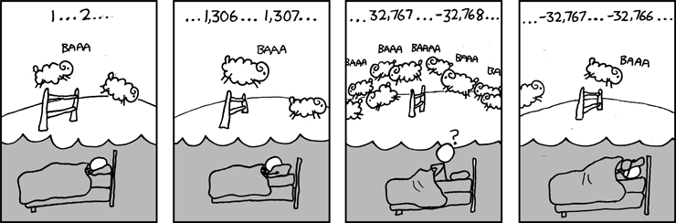
Great Reality #1: Ints are not integers, floats are not reals
Example 1: Is x² ≥ 0?
Float’s: Yes!
Int’s:
40000 * 40000 ➙ 1,600,000,000
50000 * 50000 ➙ ??
Example 2: Is (x + y) + z = x + (y + z)?
Unsigned & Signed Int’s: Yes!
Float’s:
(1e20 + -1e20) + 3.14 --> 3.14
1e20 + (-1e20 + 3.14) --> ??
-352,516,352
Source: xkcd.com/571

Slide 5
Memory referencing bug example
double fun(int i)
{
volatile double d[1] = {3.14};
volatile long int a[2];
a[i] = 1073741824; /* Possibly out of bounds */
return d[0];
}
fun(0) ➙ 3.14
fun(1) ➙ 3.14
fun(2) ➙ 3.1399998664856
fun(3) ➙ 2.00000061035156
fun(4) ➙ 3.14, then segmentation fault
Result is architecture specific

Slide 6
Memory system performance example
void copyij(int src[2048][2048],
int dst[2048][2048])
{
int i,j;
for (i = 0; i < 2048; i++)
for (j = 0; j < 2048; j++)
dst[i][j] = src[i][j];
}
void copyji(int src[2048][2048],
int dst[2048][2048])
{
int i,j;
for (j = 0; j < 2048; j++)
for (i = 0; i < 2048; i++)
dst[i][j] = src[i][j];
}
21 times slower (Pentium 4)
Hierarchical memory organization
Performance depends on access patterns
Including how step through multi-dimensional array

Slide 7
Execution Model for Modern Computers
Fetch one instruction from memory
Increment Program Counter
Read Register(s)
Perform ONE integer operation
Access Memory
Write to Register

Slide 8
Assembly Programmer’s View
A carefully crafted illusion!
Processor
Memory
Registers
Addresses
PC
Object Code
Program Data
OS Data
Data
Condition
Codes
Instructions
Stack
Programmer-Visible State
PC: Program counter
Address of next instruction
Called “EIP” (IA32) or “RIP” (x86-64)
Register file
Heavily used program data
Condition codes
Store status information about most recent arithmetic operation
Used for conditional branching
Memory
Byte addressable array
Code, user data, (some) OS data
Includes stack used to support functions

Slide 9
x86-64 Integer Registers
%rax
%r8
%eax
%r8d
%rbx
%r9
%ebx
%r9d
%rcx
%r10
%ecx
%r10d
%rdx
%r11
%edx
%r11d
%rsi
%r12
%esi
%r12d
%rdi
%r13
%edi
%r13d
%rsp
%r14
%esp
%r14d
%rbp
%r15
%ebp
%r15d
Extend existing registers. Add 8 new ones.
Make %ebp/%rbp general purpose

Slide 10
Integer Registers (IA32)
Origin
(mostly obsolete)
%eax
%ax
%ah
%al
accumulate
%ecx
%cx
%ch
%cl
counter
%edx
%dx
%dh
%dl
data
general purpose
%ebx
%bx
%bh
%bl
base
%esi
source
index
%si
%edi
destination
index
%di
%esp
stack
pointer
%sp
%ebp
base
pointer
%bp
16-bit virtual registers
(backwards compatibility)

Slide 11
32-bit code for swap
swap:
pushl %ebp
movl %esp,%ebp
pushl %ebx
movl 8(%ebp), %edx
movl 12(%ebp), %ecx
movl (%edx), %ebx
movl (%ecx), %eax
movl %eax, (%edx)
movl %ebx, (%ecx)
popl %ebx
popl %ebp
ret
void swap(int *xp, int *yp)
{
int t0 = *xp;
int t1 = *yp;
*xp = t1;
*yp = t0;
}
Set
Up
Body
Finish

Slide 12
64-bit code for swap
swap:
movl (%rdi), %edx
movl (%rsi), %eax
movl %eax, (%rdi)
movl %edx, (%rsi)
ret
Set
Up
void swap(int *xp, int *yp)
{
int t0 = *xp;
int t1 = *yp;
*xp = t1;
*yp = t0;
}
Body
Finish
Operands passed in registers (why useful?)
First (xp) in %rdi, second (yp) in %rsi
64-bit pointers
No stack operations required
32-bit data
Data held in registers %eax and %edx
movl operation

Slide 13
“For” Loop Form
Init
General Form
i = 0
for (Init; Test; Update )
Body
Test
i < WSIZE
#define WSIZE 8*sizeof(int)
long pcount_for
(unsigned long x)
{
size_t i;
long result = 0;
for (i = 0; i < WSIZE; i++)
{
unsigned bit =
(x >> i) & 0x1;
result += bit;
}
return result;
}
Update
i++
Body
{
unsigned bit =
(x >> i) & 0x1;
result += bit;
}

Slide 14
Procedure Control Flow
Use stack to support procedure call and return
Procedure call: call label
Push return address on stack
Jump to label
Return address:
Address of the next instruction right after call
Example from disassembly
Procedure return: ret
Pop address from stack
Jump to address

Slide 15
Stack Frames
Previous Frame
Frame for proc
Contents
Return information
Local storage (if needed)
Temporary space (if needed)
Management
Space allocated when enter procedure
“Set-up” code
Includes push by call instruction
Deallocated when return
“Finish” code
Includes pop by ret instruction
Frame Pointer: %rbp
(Optional) x
Stack Pointer: %rsp
Stack “Top”

Slide 16
x86-64/Linux Stack Frame
See also: Fig 3.25
Current Stack Frame (“Top” to Bottom)
“Argument build:” Parameters for function about to call
Local variables If can’t keep in registers
Saved register context
Old frame pointer (optional)
Caller Stack Frame
Return address
Pushed by call instruction
Arguments for this call
Caller
Frame
Arguments
7+
Frame pointer %rbp
Return Addr
Old %rbp
(Optional)
Saved
Registers
+
Local
Variables
Argument
Build
(Optional)
Stack pointer
%rsp

Slide 17
x86-64 Linux Memory Layout
not drawn to scale
00007FFFFFFFFFFF
Stack
Stack
Runtime stack (8MB limit)
E. g., local variables
Heap
Dynamically allocated as needed
When call malloc(), calloc(), new()
Data
Statically allocated data
E.g., global vars, static vars, string constants
Text / Shared Libraries
Executable machine instructions
Read-only
8MB
Shared
Libraries
Heap
Data
Text
Hex Address
400000
000000

Slide 18
Array Allocation
Basic Principle
T A[L];
Array of data type T and length L
Contiguously allocated region of L * sizeof(T) bytes
char string[12];
x
x + 12
int val[5];
x
x + 4
x + 8
x + 12
x + 16
x + 20
double a[3];
x
x + 8
x + 16
x + 24
char *p[3];
IA32
x
x + 4
x + 8
x + 12
char *q[3];
x86-64
x
x + 8
x + 16
x + 24

Slide 19
Reduction in Strength
Replace costly operation with simpler one
Shift, add instead of multiply or divide
16*x --> x << 4
Utility machine dependent
Depends on cost of multiply or divide instruction
On Intel Nehalem, integer multiply requires 3 CPU cycles
Recognize sequence of products
int ni = 0;
for (i = 0; i < n; i++) {
for (j = 0; j < n; j++)
a[ni + j] = b[j];
ni += n;
}
for (i = 0; i < n; i++) {
int ni = n*i;
for (j = 0; j < n; j++)
a[ni + j] = b[j];
}

Slide 20
Share Common Subexpressions
Reuse portions of expressions
GCC will do this with –O1
/* Sum neighbors of i,j */
up = val[(i-1)*n + j ];
down = val[(i+1)*n + j ];
left = val[i*n + j-1];
right = val[i*n + j+1];
sum = up + down + left + right;
long inj = i*n + j;
up = val[inj - n];
down = val[inj + n];
left = val[inj - 1];
right = val[inj + 1];
sum = up + down + left + right;
3 multiplications: i*n, (i–1)*n, (i+1)*n
1 multiplication: i*n
leaq 1(%rsi), %rax # i+1
leaq -1(%rsi), %r8 # i-1
imulq %rcx, %rsi # i*n
imulq %rcx, %rax # (i+1)*n
imulq %rcx, %r8 # (i-1)*n
addq %rdx, %rsi # i*n+j
addq %rdx, %rax # (i+1)*n+j
addq %rdx, %r8 # (i-1)*n+j
imulq %rcx, %rsi # i*n
addq %rdx, %rsi # i*n+j
movq %rsi, %rax # i*n+j
subq %rcx, %rax # i*n+j-n
leaq (%rsi,%rcx), %rcx # i*n+j+n

Slide 21
Byte Ordering on IA32
Little Endian
f0 | f1 | f2 | f3 | f4 | f5 | f6 | f7
c[0] | c[1] | c[2] | c[3] | c[4] | c[5] | c[6] | c[7]
s[0] |  | s[1] |  | s[2] |  | s[3]
i[0] |  |  |  | i[1]
l[0]
LSB
MSB
LSB
MSB
Print
Output:
Characters 0-7 == [0xf0,0xf1,0xf2,0xf3,0xf4,0xf5,0xf6,0xf7]
Shorts 0-3 == [0xf1f0,0xf3f2,0xf5f4,0xf7f6]
Ints 0-1 == [0xf3f2f1f0,0xf7f6f5f4]
Long 0 == [0xf3f2f1f0]

Slide 22
Byte Ordering on Sun
Big Endian
f0 | f1 | f2 | f3 | f4 | f5 | f6 | f7
c[0] | c[1] | c[2] | c[3] | c[4] | c[5] | c[6] | c[7]
s[0] |  | s[1] |  | s[2] |  | s[3]
i[0] |  |  |  | i[1]
l[0]
MSB
LSB
MSB
LSB
Print
Output on SPARC/IBM, etc.:
Characters 0-7 == [0xf0,0xf1,0xf2,0xf3,0xf4,0xf5,0xf6,0xf7]
Shorts 0-3 == [0xf0f1,0xf2f3,0xf4f5,0xf6f7]
Ints 0-1 == [0xf0f1f2f3,0xf4f5f6f7]
Long 0 == [0xf0f1f2f3]

Slide 23
Memory Referencing Bug Example
typedef struct {
int a[2];
double d;
} struct_t;
fun(0) ➙ 3.14
fun(1) ➙ 3.14
fun(2) ➙ 3.1399998664856
fun(3) ➙ 2.00000061035156
fun(4) ➙ 3.14
fun(6) ➙ Segmentation fault
Explanation:
Critical State | 6
? | 5
? | 4
d7 ... d4 | 3
d3 ... d0 | 2
a[1] | 1
a[0] | 0
Location accessed by fun(i)
struct_t

Slide 24
Such problems are a BIG deal
Generally called a “buffer overflow”
when exceeding the memory size allocated for an array
Why a big deal?
It’s the #1 technical cause of security vulnerabilities
#1 overall cause is social engineering / user ignorance
Most common form
Unchecked lengths on string inputs
Particularly for bounded character arrays on the stack
sometimes referred to as stack smashing

Slide 25
Modern CPU Design
Instruction Control
Fetch
Control
Address
Instruction
Cache
Retirement
Unit
Register
File
Instruction
Decode
Instructions
Operations
Register Updates
Prediction OK?
Execution
Functional
Units
Branch
Arith
Arith
Arith
Load
Store
Operation Results
Addr.
Addr.
Data
Data
Data
Cache

Slide 26
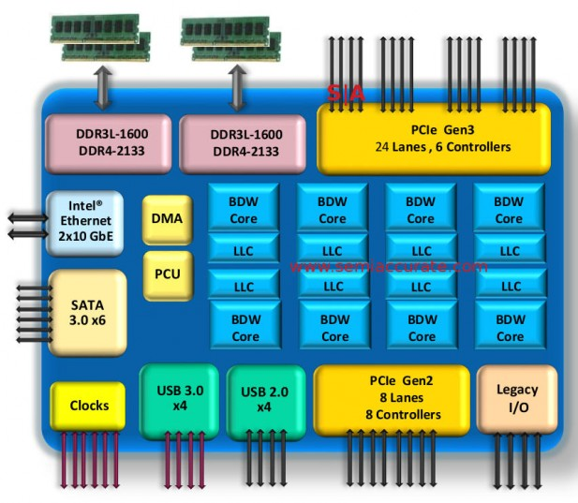
2015 State of the Art
Core i7 Broadwell 2015
Desktop Model
4 cores
Integrated graphics
3.3-3.8 GHz
65W
Server Model
8 cores
Integrated I/O
2-2.6 GHz
45W

Slide 27
The Memory Mountain
Core i7 Haswell
2.1 GHz
32 KB L1 d-cache
256 KB L2 cache
8 MB L3 cache
64 B block size
Aggressive prefetching
L1
Ridges
of temporal locality
L2
L3
Slopes
of spatial locality
Mem
Fig. §6.41

Slide 28
Much more to computers …
… than you ever expected
Can make an entire career out of them …
… or simply buy them and use them!

Slide 29
Thank you for your interest and attention
Questions?

